Slide 1
MMR
A Case Study in a Cross Functional Project
“Building Bridges with a POC”
KROLL BOND RATING AGENCY, INC

Slide 2
Agenda
What is MMR?
Business Domain: Municipal Market Ratings
Technology: R and Shiny
Who is involved with it?
Product Owner
Data Science & Quantitative Modeling
Outside Resources
Members of the PA Technology Center.
Deep Dive into the world of R
RStudio
Shiny

Slide 3
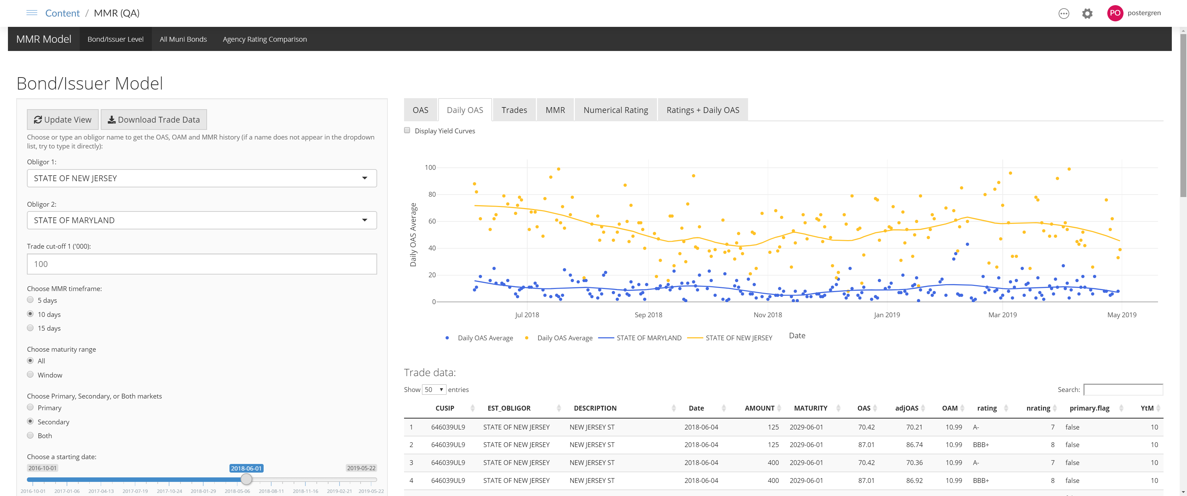
Agenda
A story of the Data Team and the Dev Team working to meet Business Goals
Notes:
Application as seen through a Web Browser, MMR is known as Municipal Market Rating from project charter, but what is OAS?

Slide 4
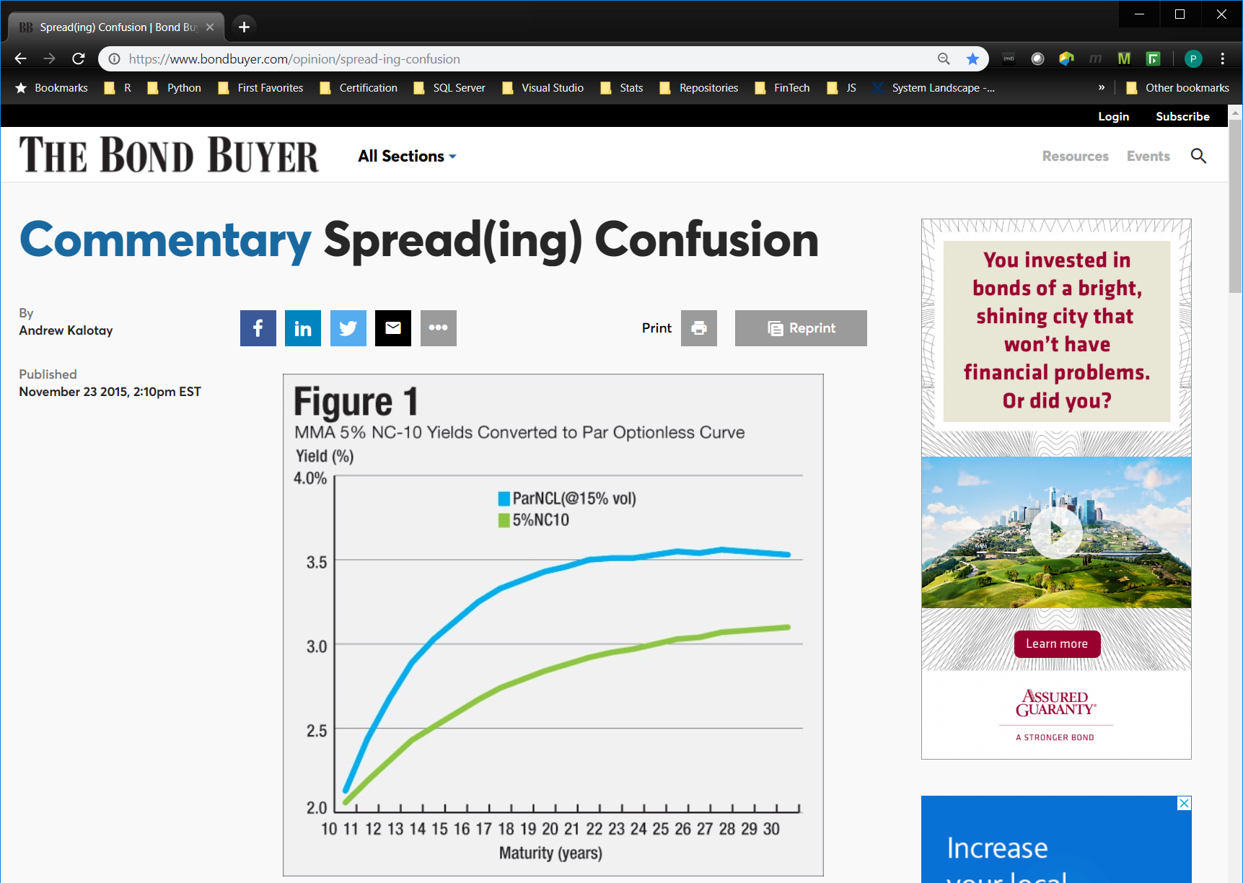
Basic Research
Business Domain
Notes:
Reviewing background information shows this author coming up in several search results, who is he?

Slide 5
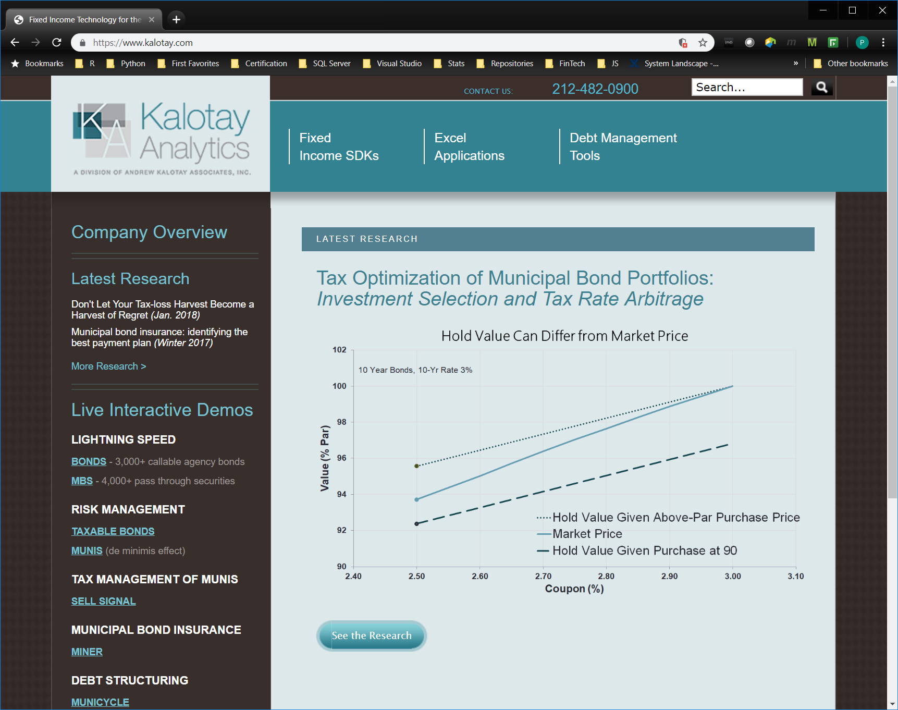
Basic Research
Research on the author
Notes:
The author of the article has his own firm and again we see the visual mode of interacting with the data.

Slide 6

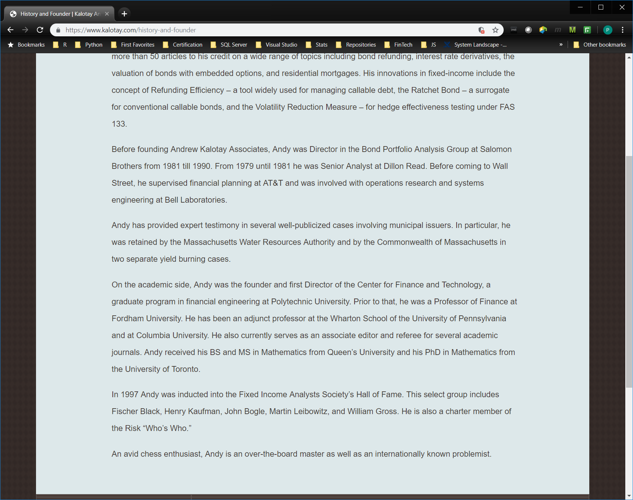
Basic Research
Deep Dive on the author
Notes:
Analytical foundation in both the academic sphere as well as the competitive sphere.

Slide 7

Additional Personas
External Resources Brought in
Notes:
An outside resource brought in apply rigor to our development process. (Is there a little girl on the other side of this picture facing the bull?)

Slide 8
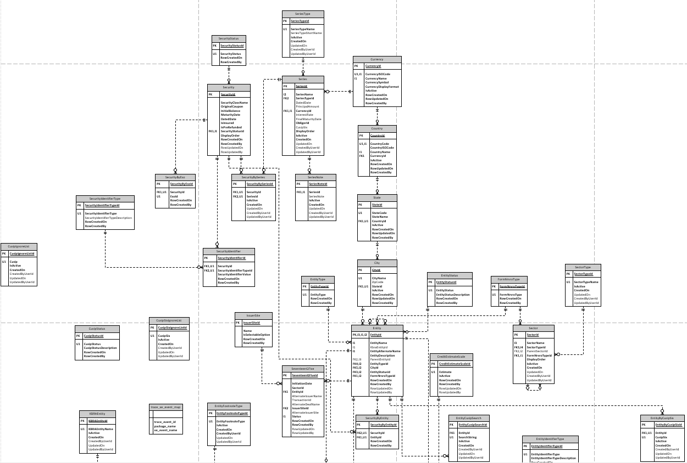
Data Team Context
Notes:
Bronze age of databases, the original normalized database schema.

Slide 9
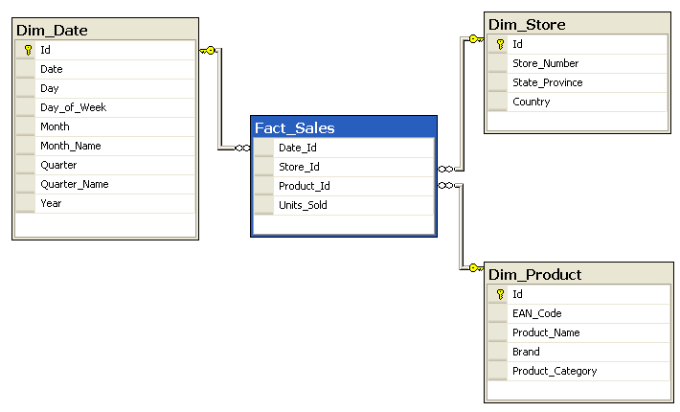
Data Team Context
Notes:
Iron age of databases, the infamous “Star Schema”

Slide 10
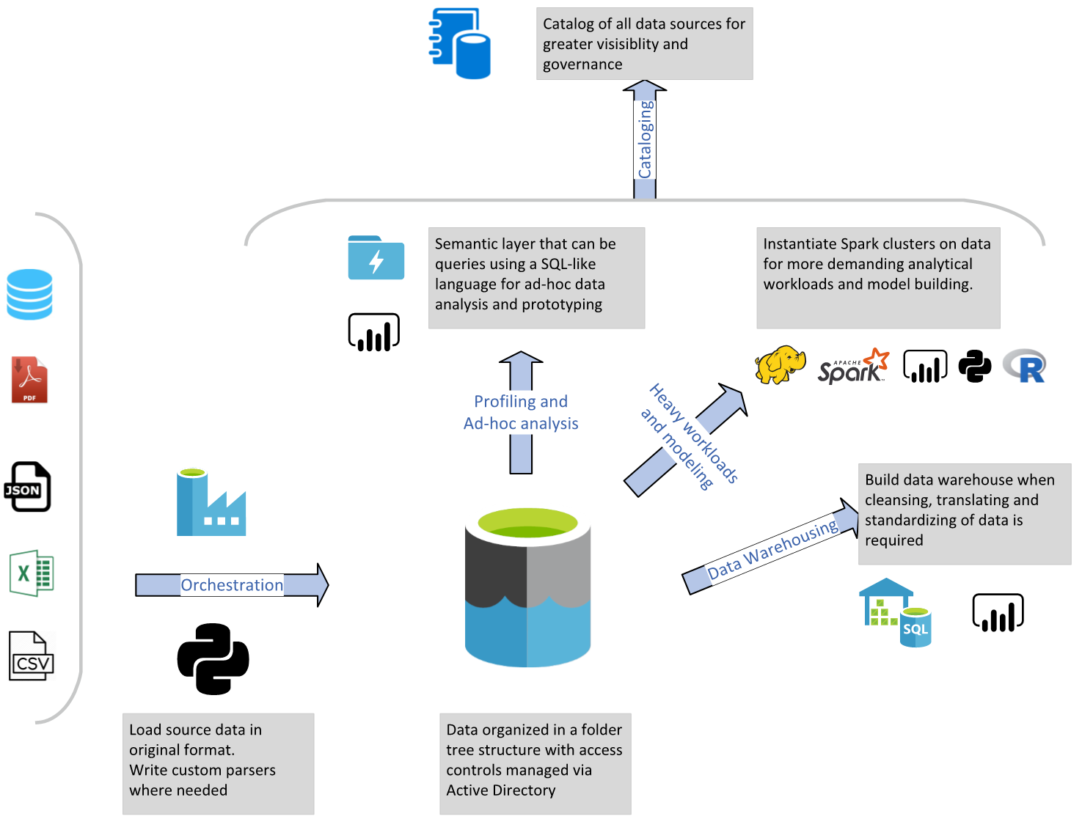
Data Team Context – Data 2.0
Notes:
Data 2.0 is the Industrial Revolution as applied to Databases.

Slide 11
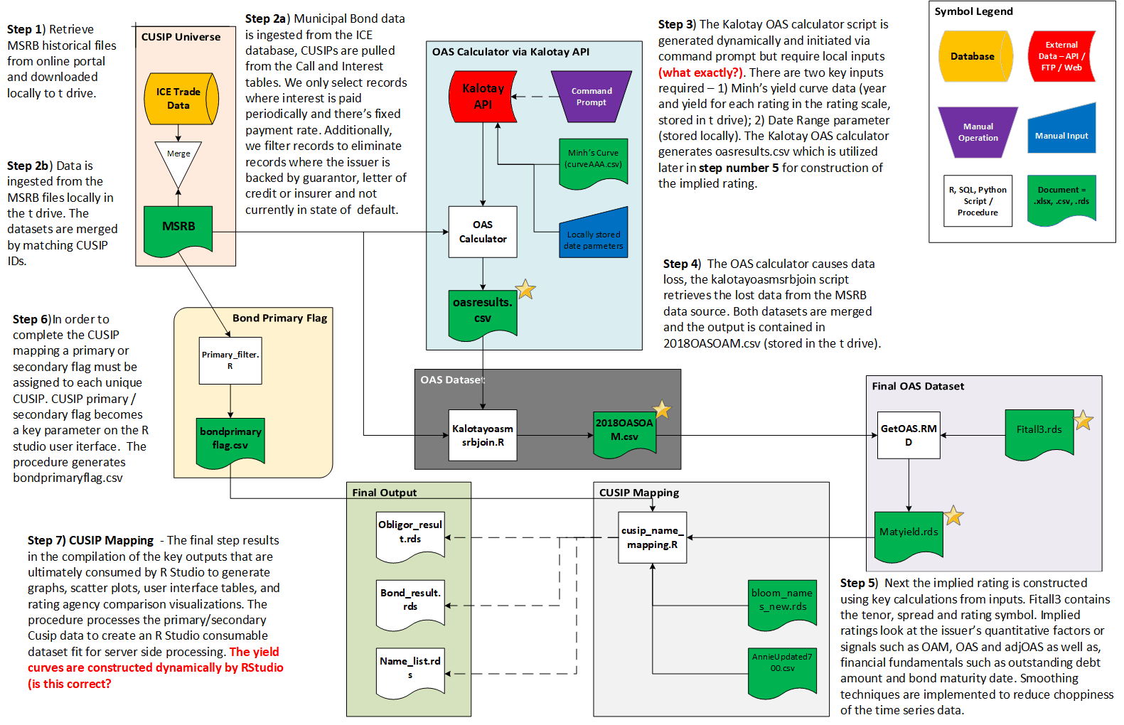
MMR Data Flow Diagram
Notes:
Here is a simplified representation of the data flow supporting the MMR application you saw in the web browser. Notice the red item right in the ‘heart’ of this diagram. In fact the Kalotay API center that the entire application revolves around. The ‘Data Structures’ utilized are a variety of file based items. Xls, csv and rds. RDS – I don’t remember seeing the exact have not seen the exact acronym, but an RDS can store a single data item. These are all the green items in the diagram, although the Final Output shown in the bottom left is using white for contrast. The Final Output data is read by the Web App. Other than those, the white rectangles (mostly) represent R scripts where R does most of its work. Starting at the top left let’s look at an R script in detail.

Slide 12
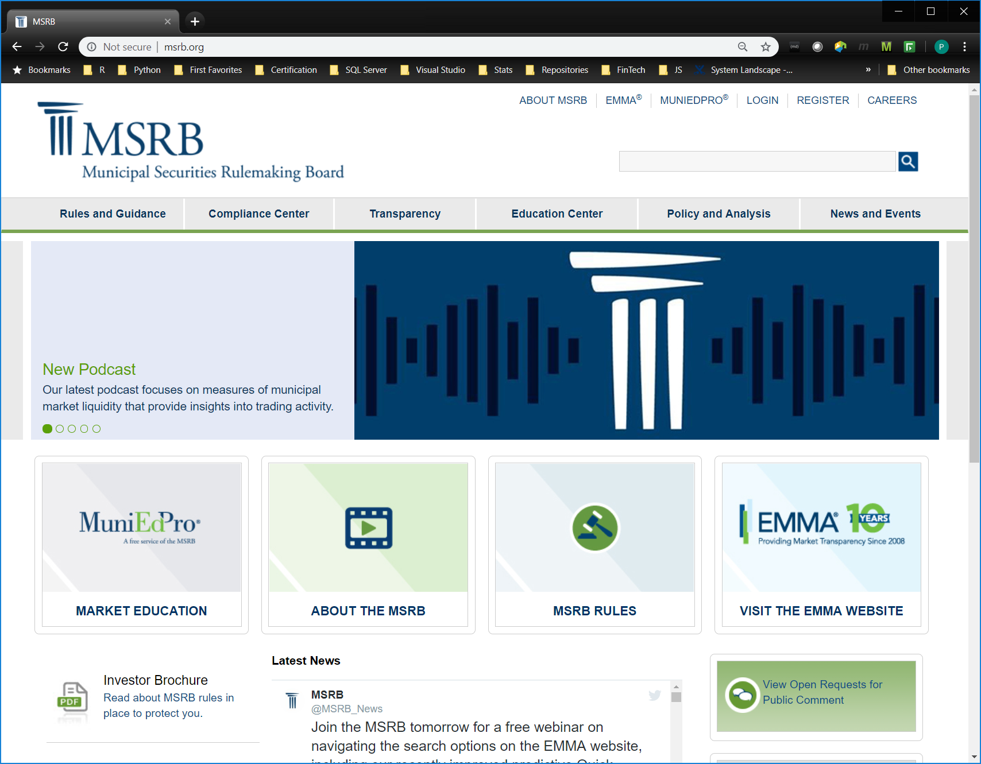
MMR Data Flow
Notes:
The Data Flow starts with merging ICE with MSRB.

Slide 13
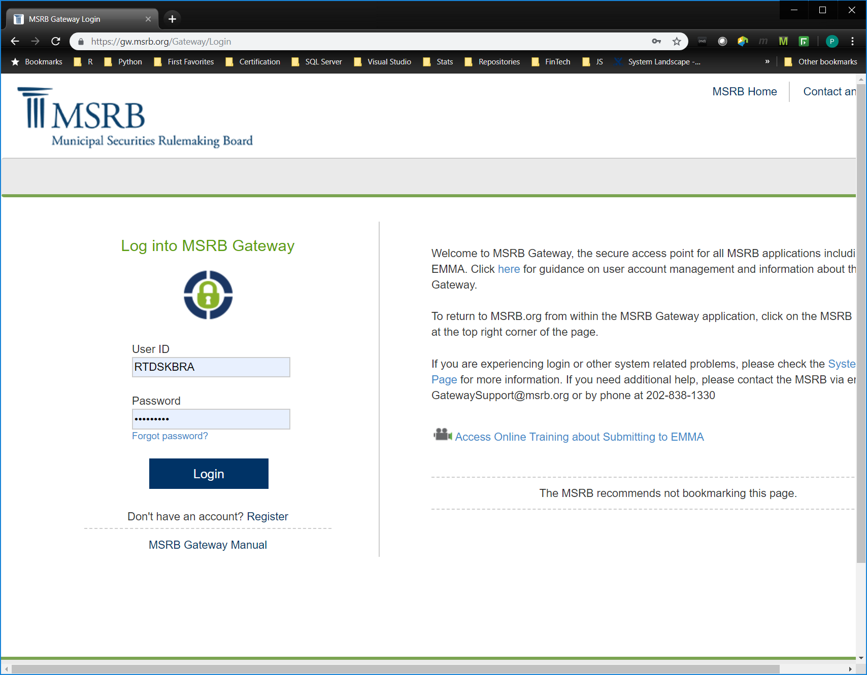
MMR Data Flow
Notes:
Login to take a “look see”

Slide 14
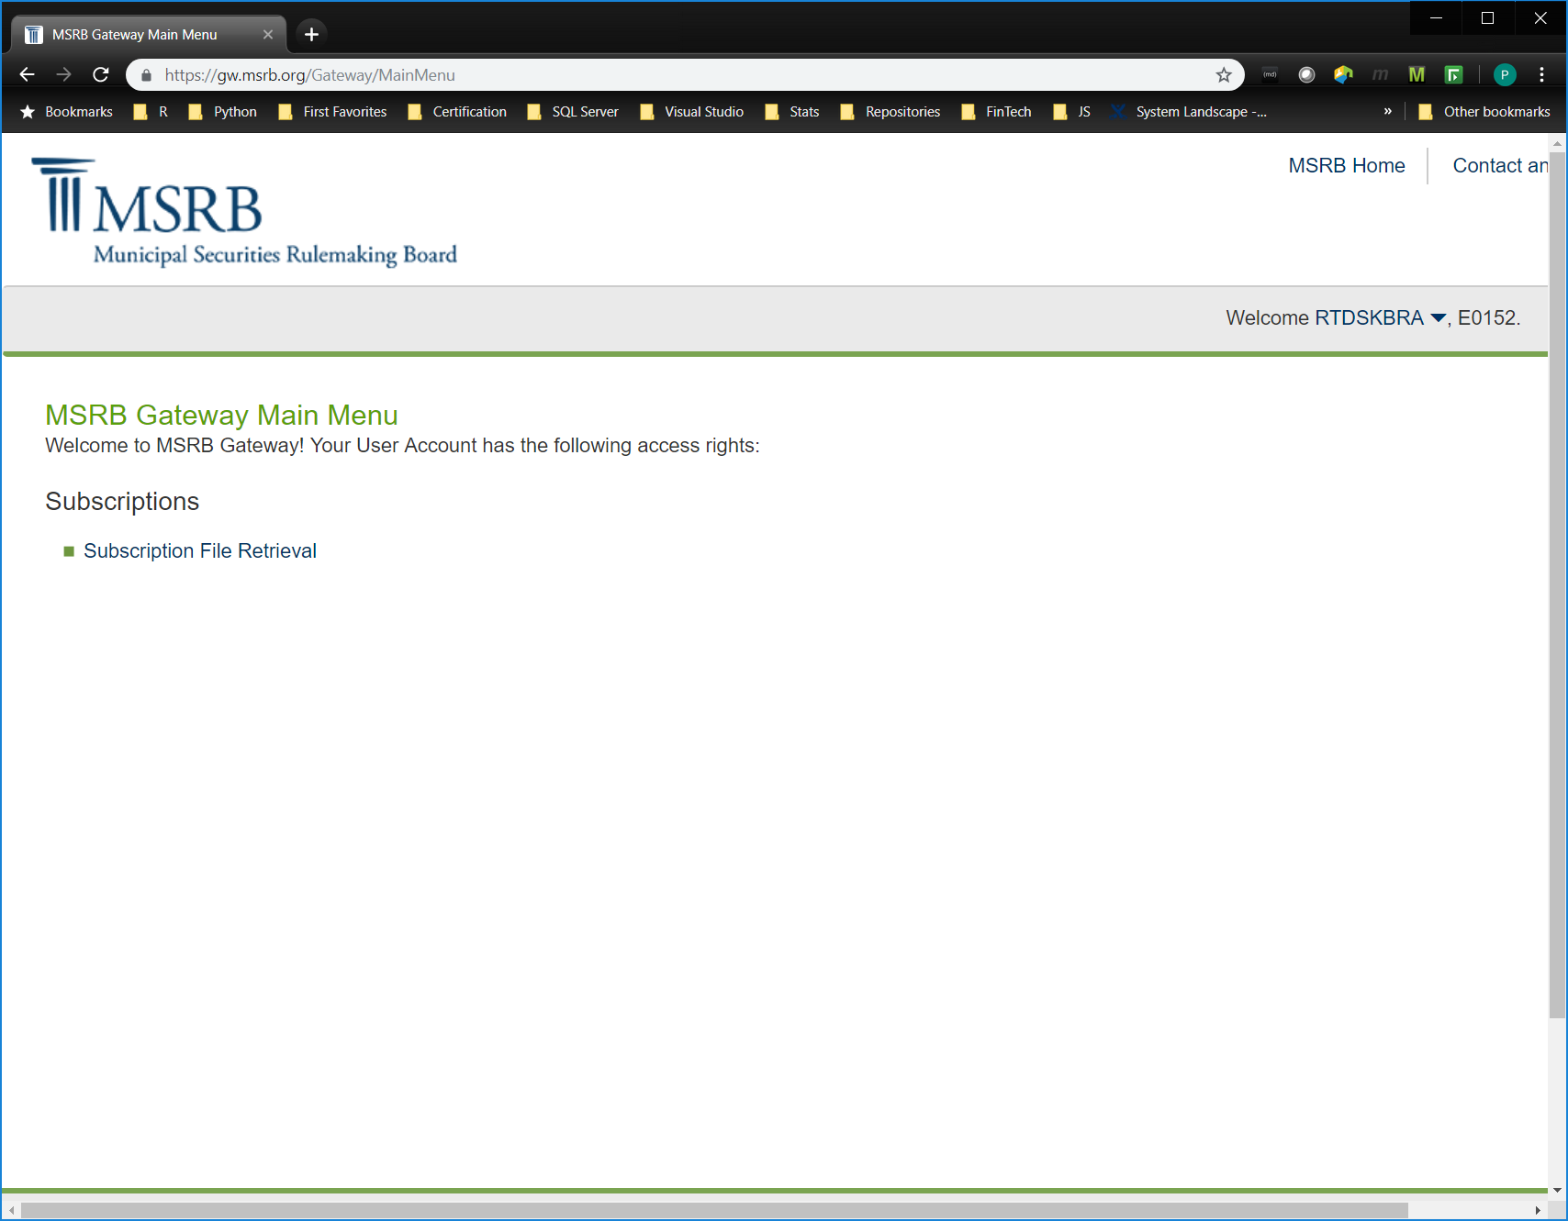
MMR Data Flow
Notes:
Welcome RTDSKBRA, re-trive-data-set?

Slide 15
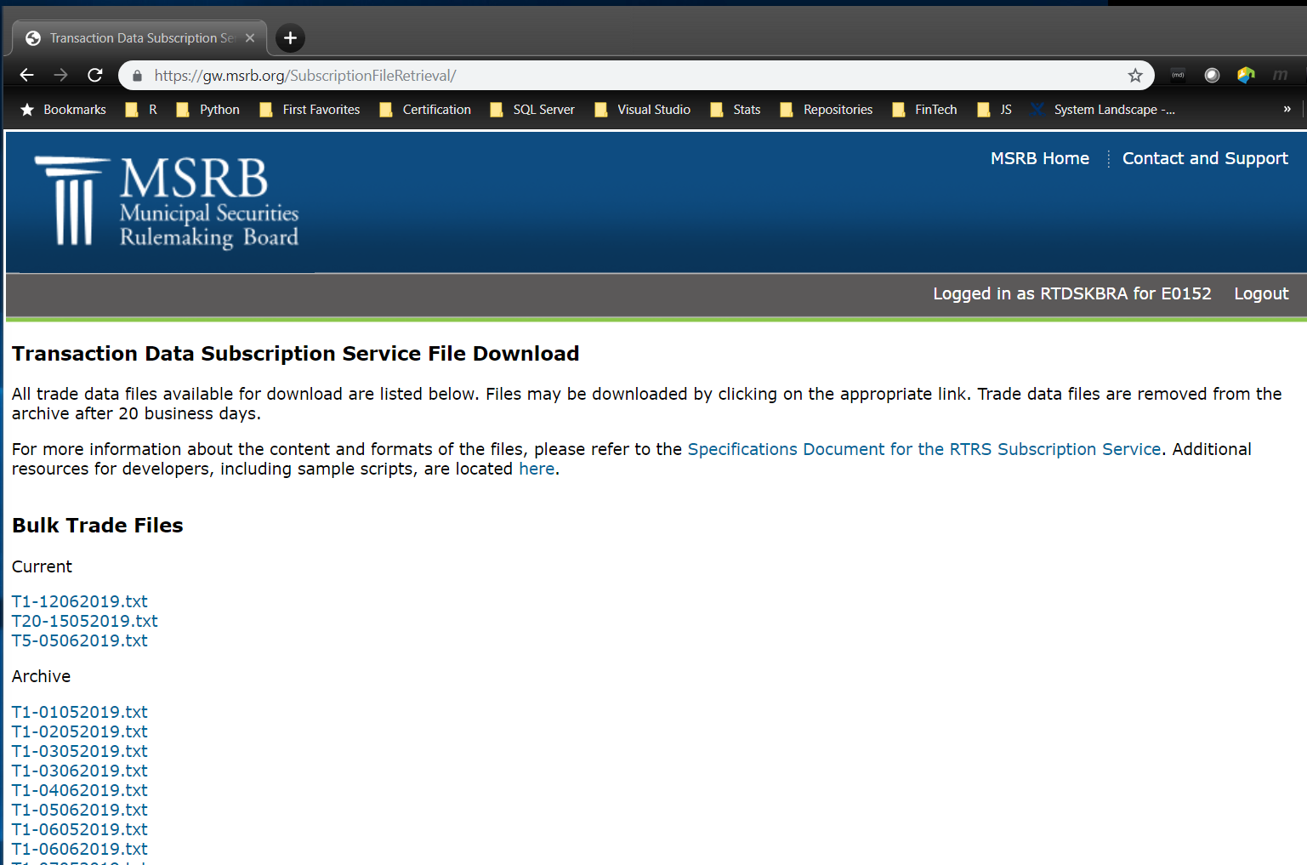
MMR Data Flow
Notes:
Every day they post three files. each one of those files are archived for 20 business days. The three types of files are T1, T20, and T5. The T1 files contain trade data from one day ago. This screenshot taken on the 13th shows the trades from one day ago, the 12th, in the T1 file for the 12th day of the 6th month of the year 2019.
The T20 file contains trades from 20 days ago and is so-named for the 15th day of the 5th month of the year 2019.

Slide 16
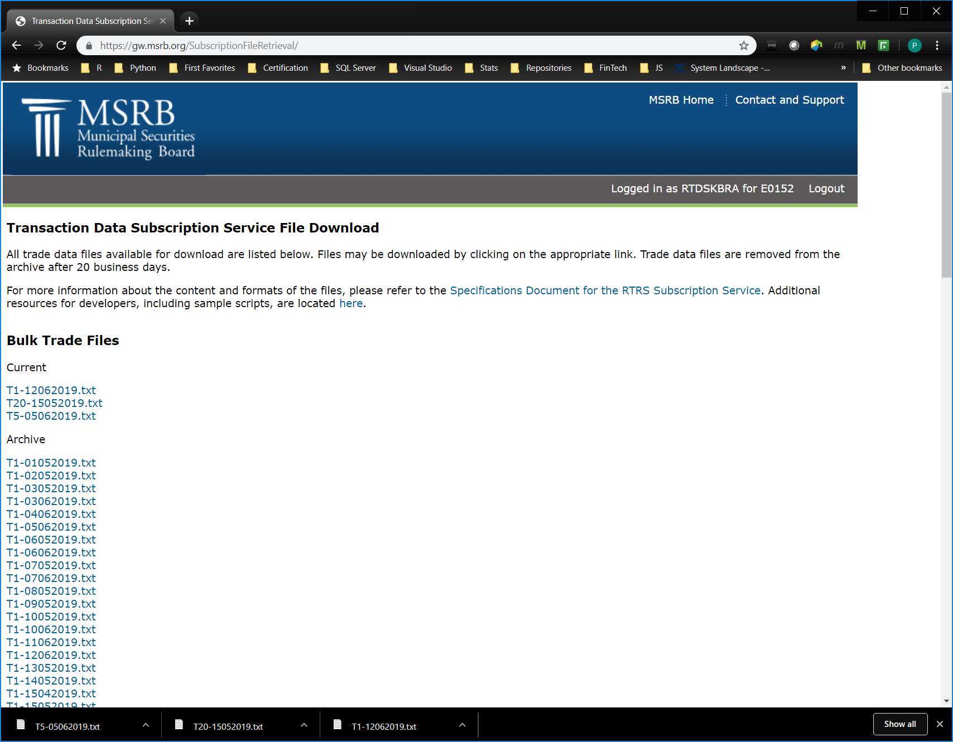
MMR Data Flow
Notes:
Click each file and you have successfully brought them into our possession.

Slide 17
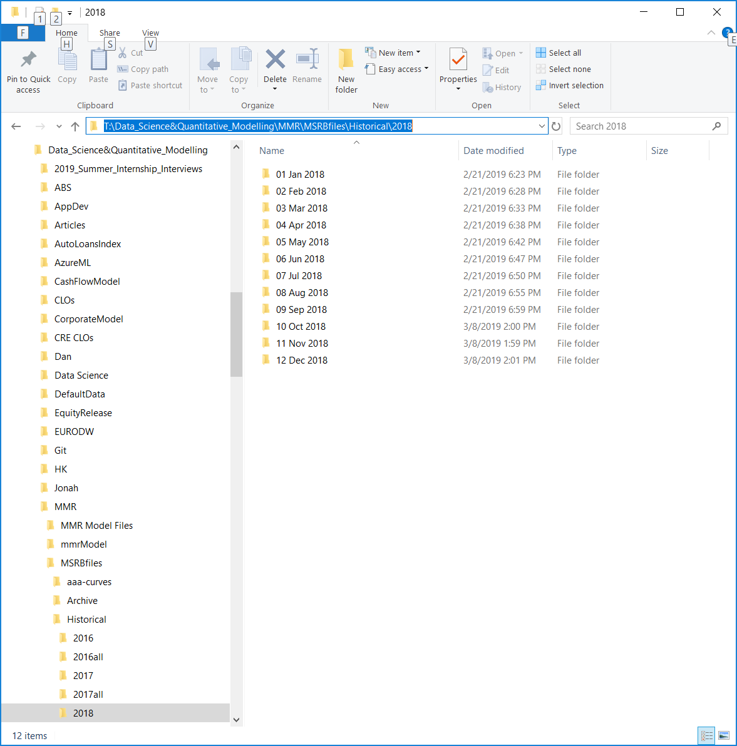
MMR Data Flow
Notes:
Now in the DSQM possession the files are stored on the T drive. The DSQM team has their folder, where they have a folder for the MMR project, where keep the MSRBfiles, Historical copies for each year, for each month.

Slide 18
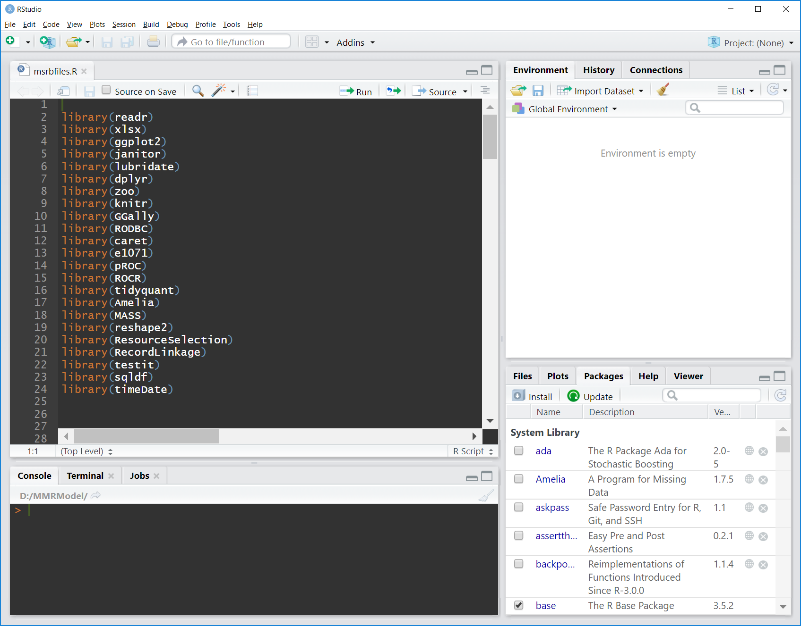
MMR Data Flow
Notes:
How are these files used? RStudio is the IDE to start with. There is no arguing with that. Anybody who is going to use an R IDE other that …
Here we see the open source libraries that can be used to multiply the power of R.

Slide 19
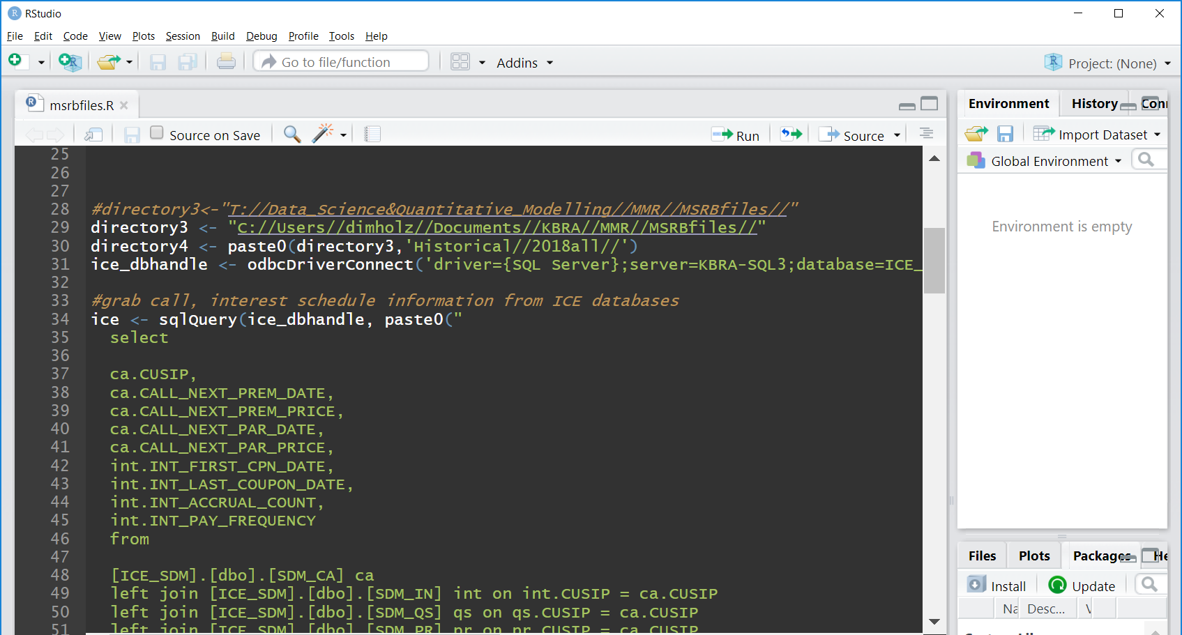
MMR Data Flow
Notes:
As was stated in the Data Flow diagram the first thing that needs to be done is merge the MSRB data with the ICE data. I assume the operator here bogged down by processing the MSRB files from the network drive so he brought a copy of the data to his local machine.

Slide 20
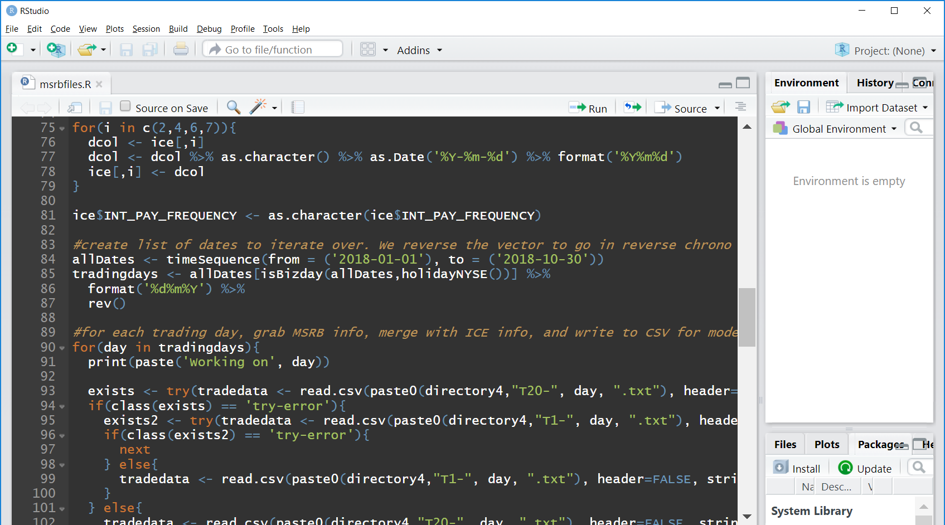
MMR Data Flow
Notes:
To deliver a certain date range to the Shinny Web App a specific date range was entered into the file prior to execution.

Slide 21
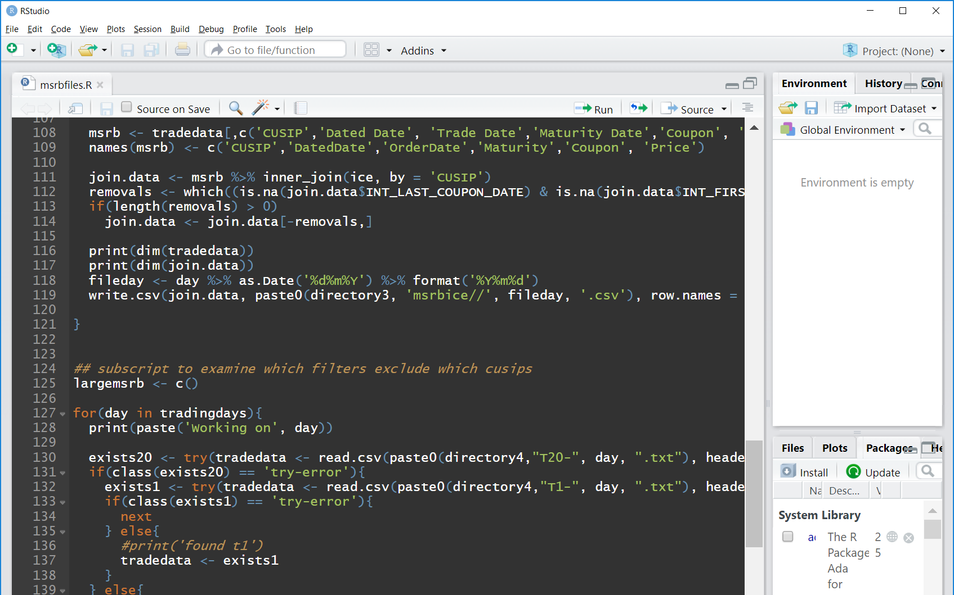
MMR Data Flow
Notes:
Join the data read in from CSV files with the data read from the ICE database and save to a CSV file.

Slide 22
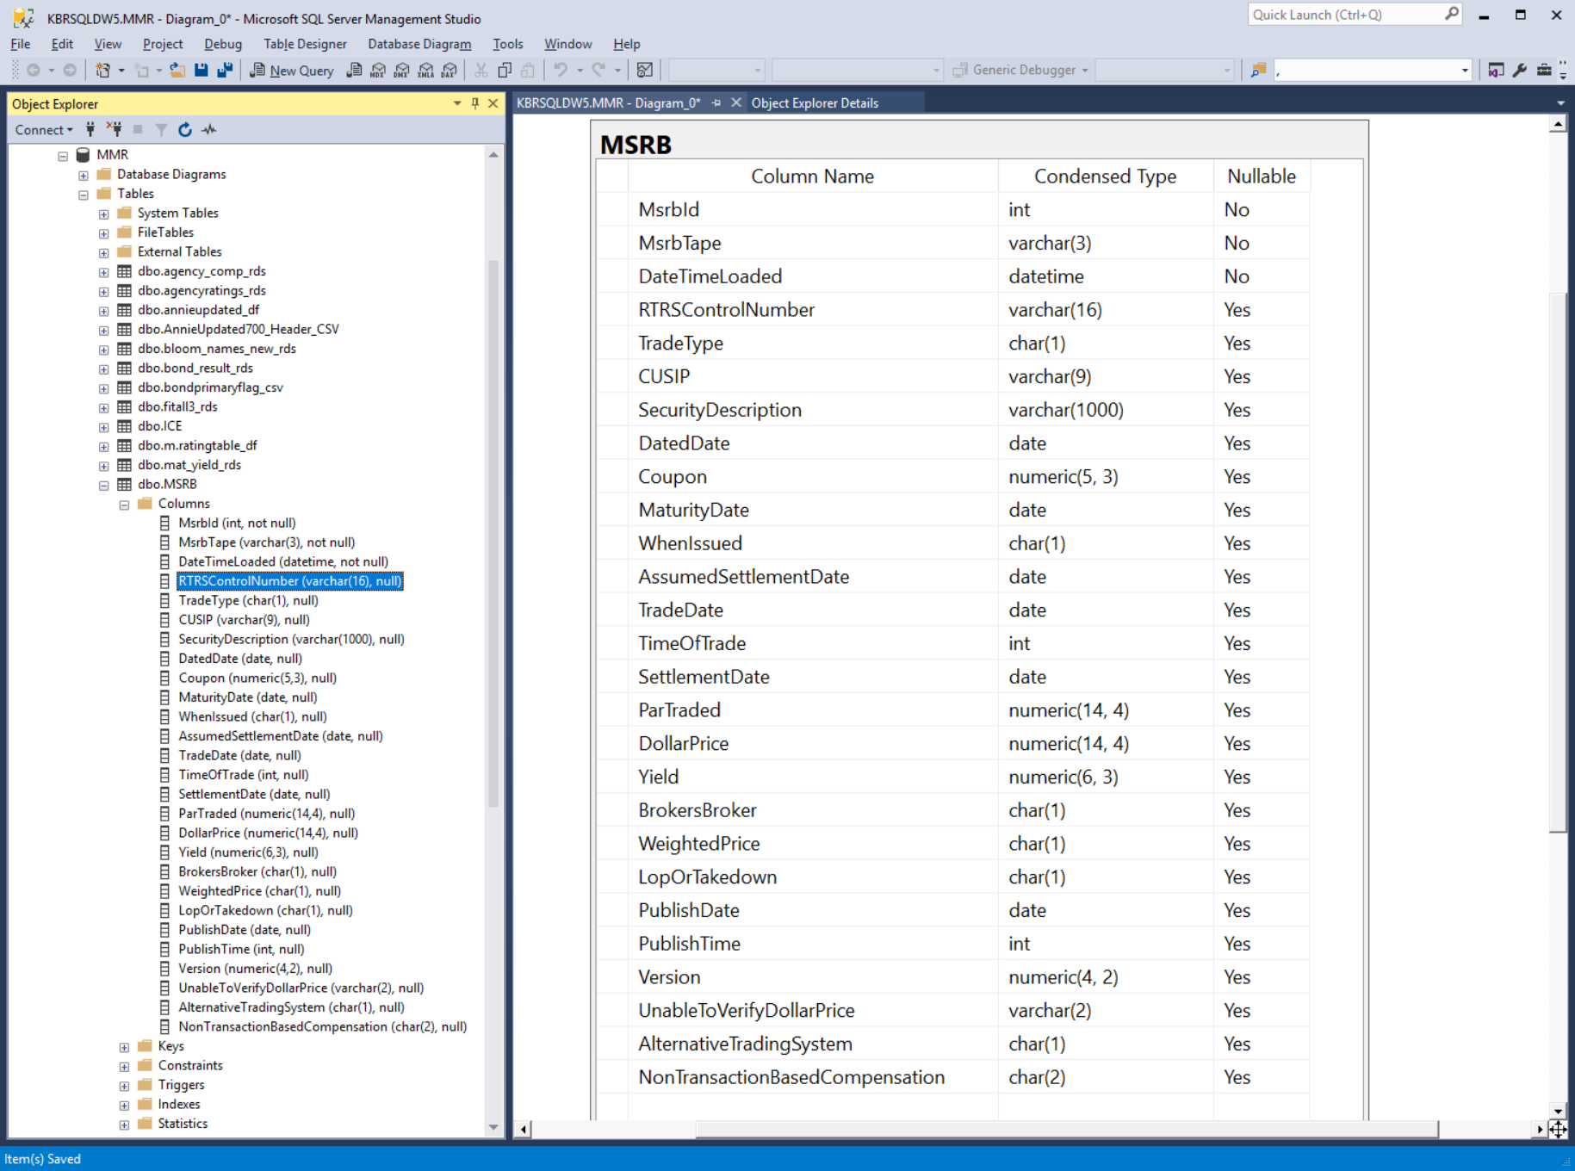
MMR Data Flow
Notes:
Instead of having all these MSRB files T1, T20, and T5 flying all over the place lets store them in a data base. Howa’bout a single table? The three columns above the RTRSControlNumber are our columns tracking from which file and whence the data has the data been supplied.

Slide 23
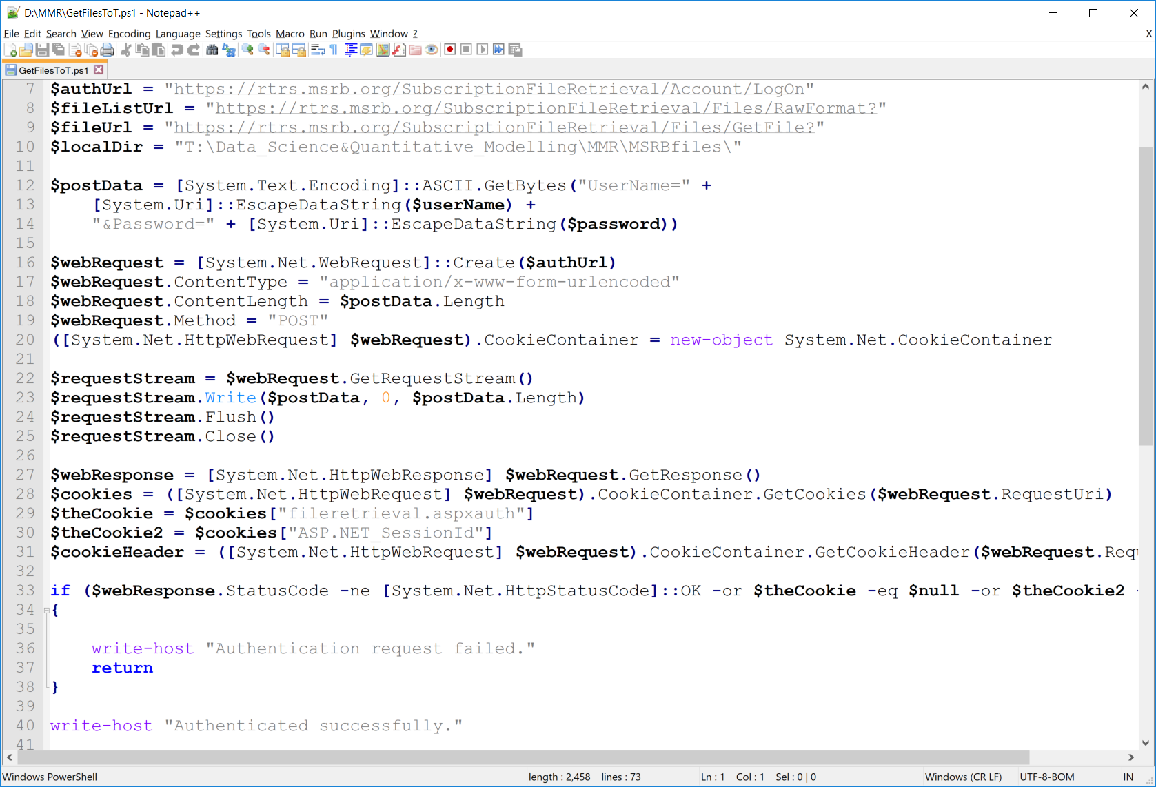
MMR Data Flow
Notes:
Easy part is downloading the files, as it turns out a PowerShell script is the best way to do it.

Slide 24
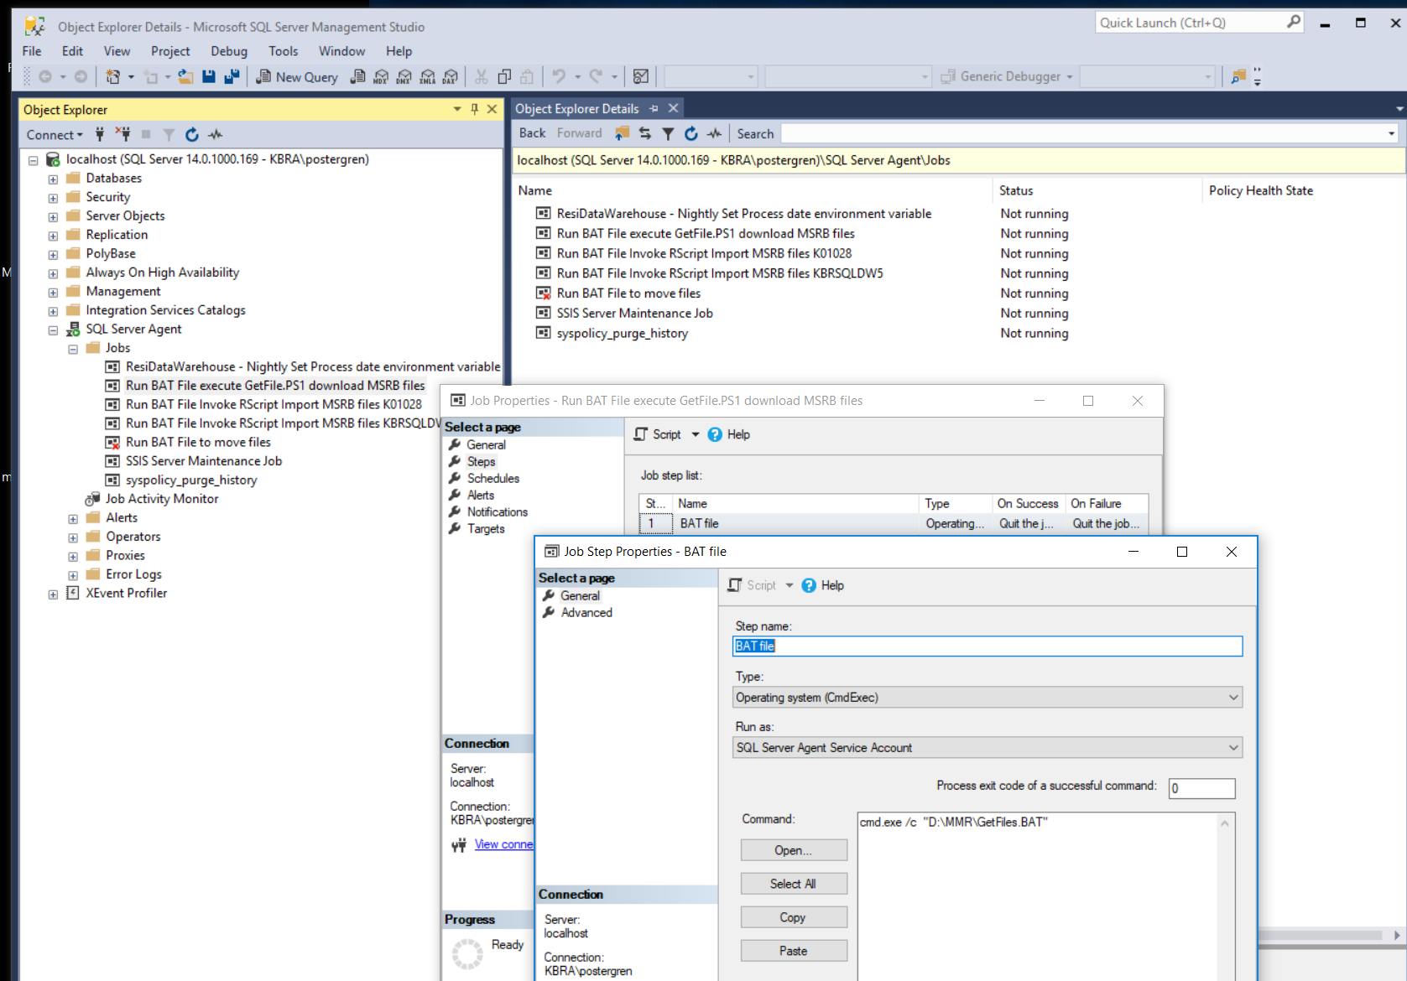
MMR Data Flow
Notes:
Since we are putting the files into a database table, let’s use a SQL Server Agent Job to run the script that downloads the files. Well okay, we may want to use The Jenkins or some such so lets use a BAT file to make it portable.

Slide 25
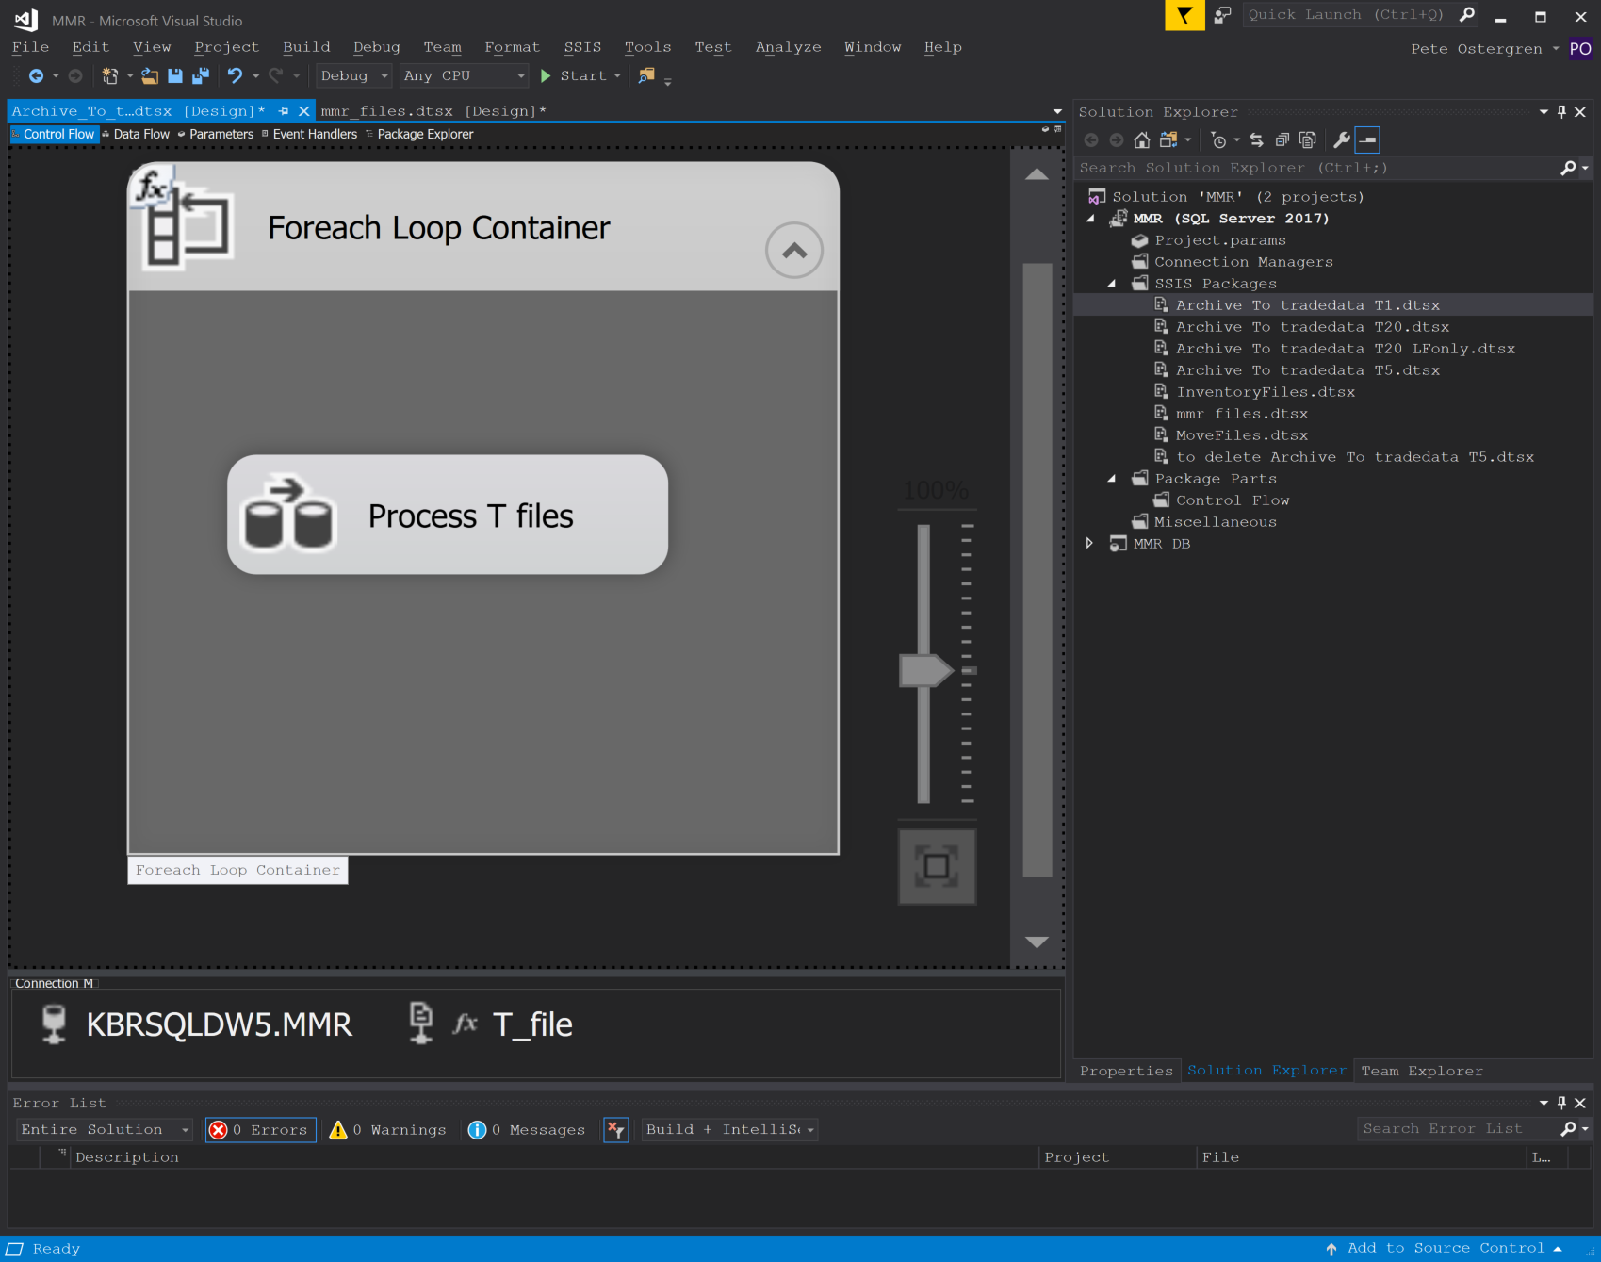
MMR Data Flow
Notes:
Okay, now we have these flat files, let’s put them in the database. So, fire up Visual Studio and create a data flow task to loop through all the T files.

Slide 26
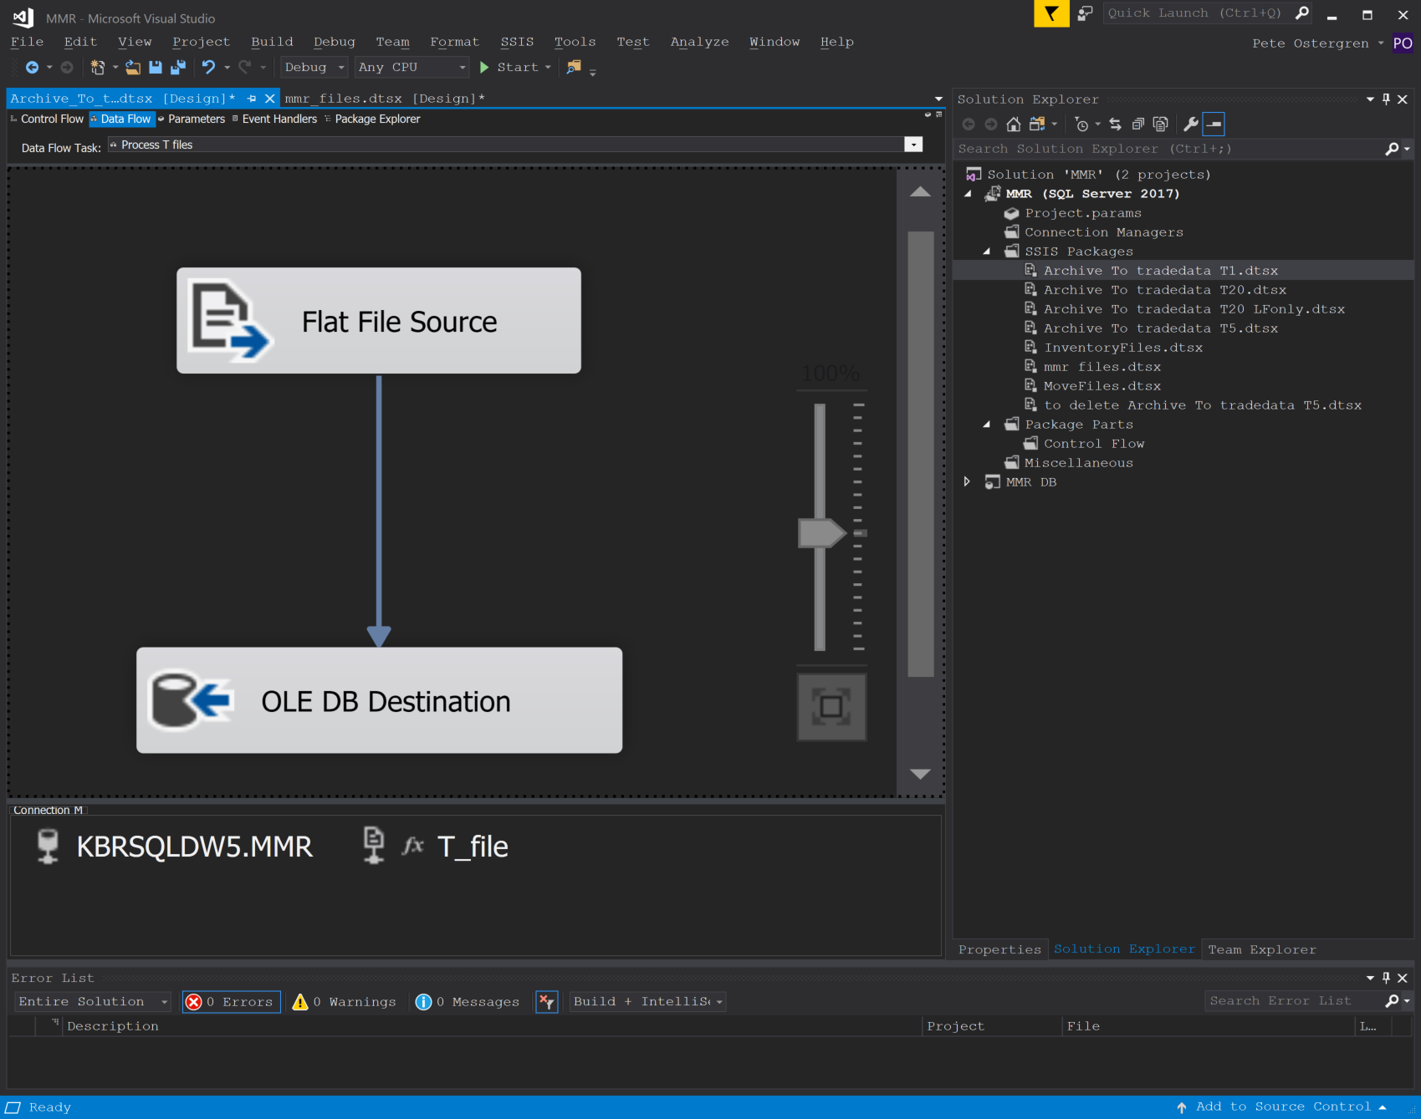
MMR Data Flow
Notes:
You don’t even have to write any code to do that. But wait, you shouldn’t kill the chickens in front of the cows. The people currently on the project just want to use R.

Slide 27
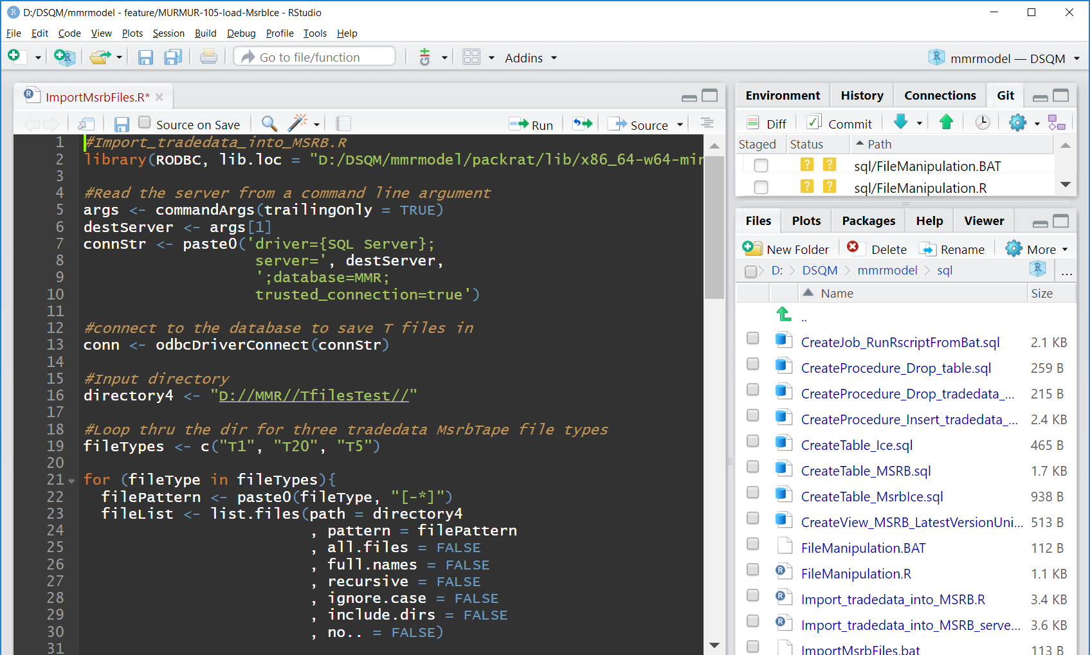
MMR Data Flow
Notes:
Use R as an ETL tool, connect to a database, loop thru a file folder…

Slide 28
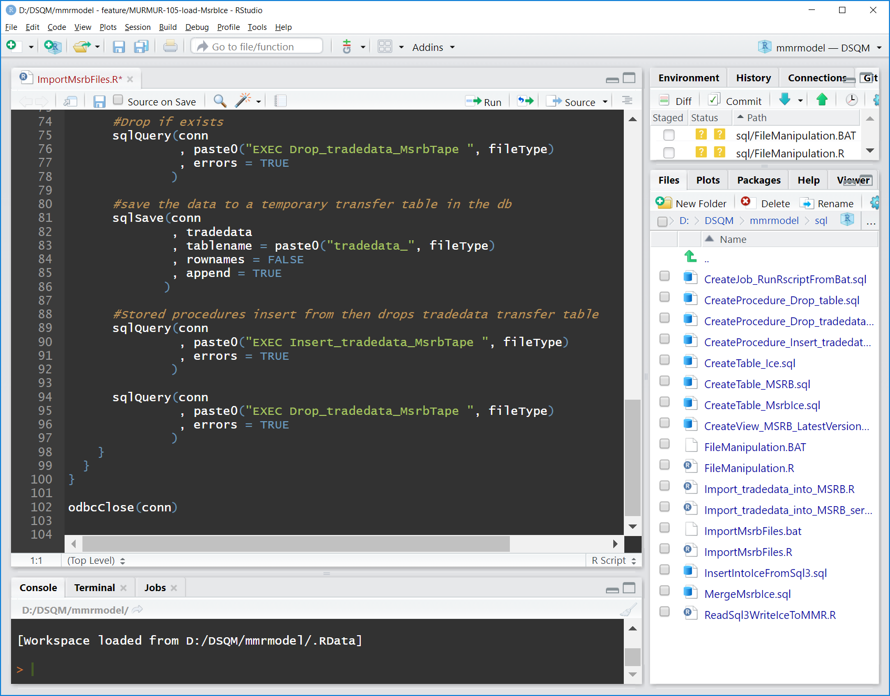
MMR Data Flow
Notes:
So far the best usage of the sqlSave function in R is to let R create a table for each set of data (a temporary transfer table) and then let the database transfer to the final table.

Slide 29
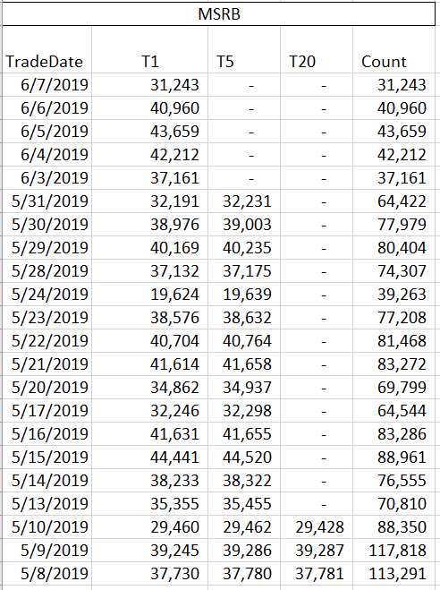
MMR Data Flow
Notes:
Pulling the trade data out of the table grouping by TradeDate you can see the staircase effect of the Draft, edited and final versions. Notice the 5/10 and 5/9 flow of data. First the count goes up, then it goes down, or doesn't. The ultimate goal of having the data in a table is to join it to the data we have in the ICE database. We will want to join the latest data. How will we do that? One day, five days, twenty days? Weekends? Holidays?

Slide 30
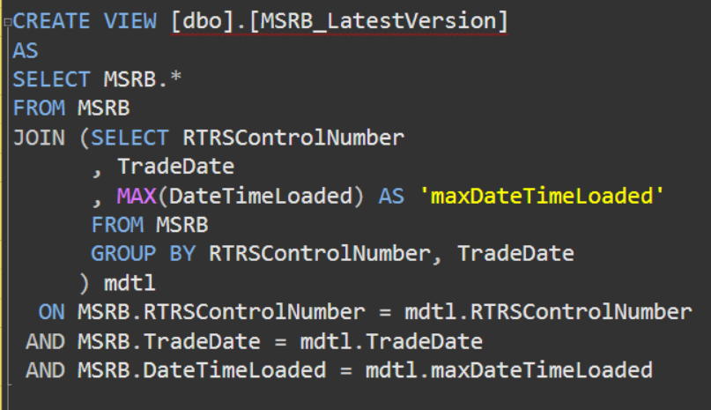
MMR Data Flow
Notes:
Using our standard ‘Latest Version’ view the thought is that T20’s will always be the last row loaded for a particular trade. If we don’t have T20’s then the T5’s will be the latest version received, etc. However, performance was an issue.

Slide 31
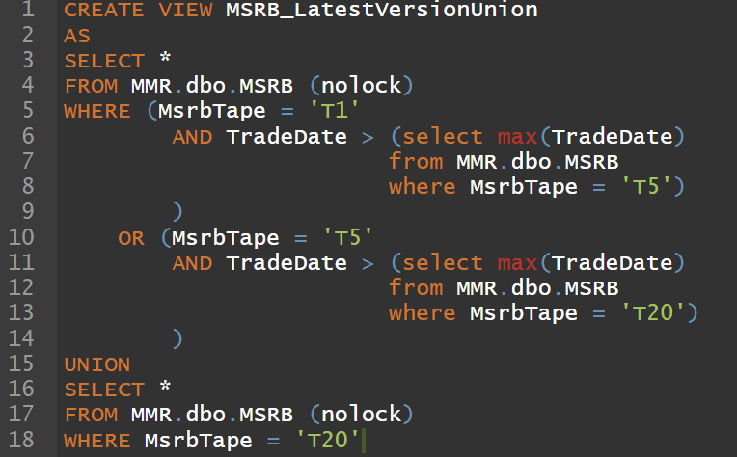
MMR Data Flow
Notes:
A more performant and simpler version: Take T1’s until you get T5’, take T5’s until you get T20’s, always take T20’s. Highly performant.

Slide 32
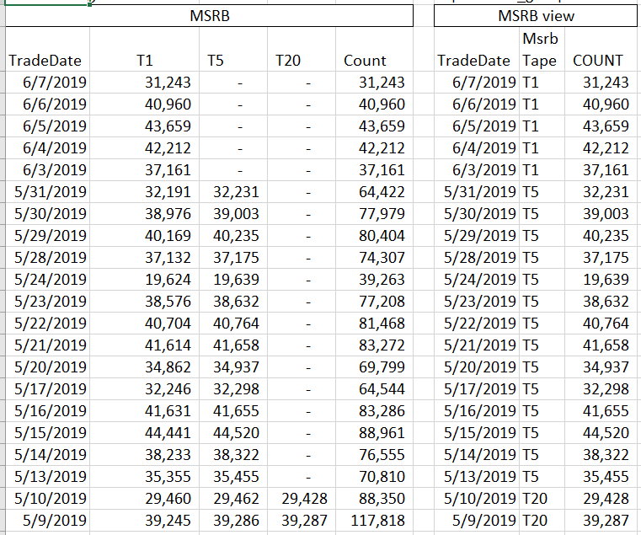
MMR Data Flow
Notes:
Here’s how it looks when we ask the table to just give us the latest version. Note: as we move from Draft to edit to final versions we add rows, change rows and delete rows. When we join to the ICE data to produce the MsrbIce table will we need to add a checksum column?
As time goes by how many people see the MsrbTape column moving up? How many people see the TradeDate moving down?

Slide 33
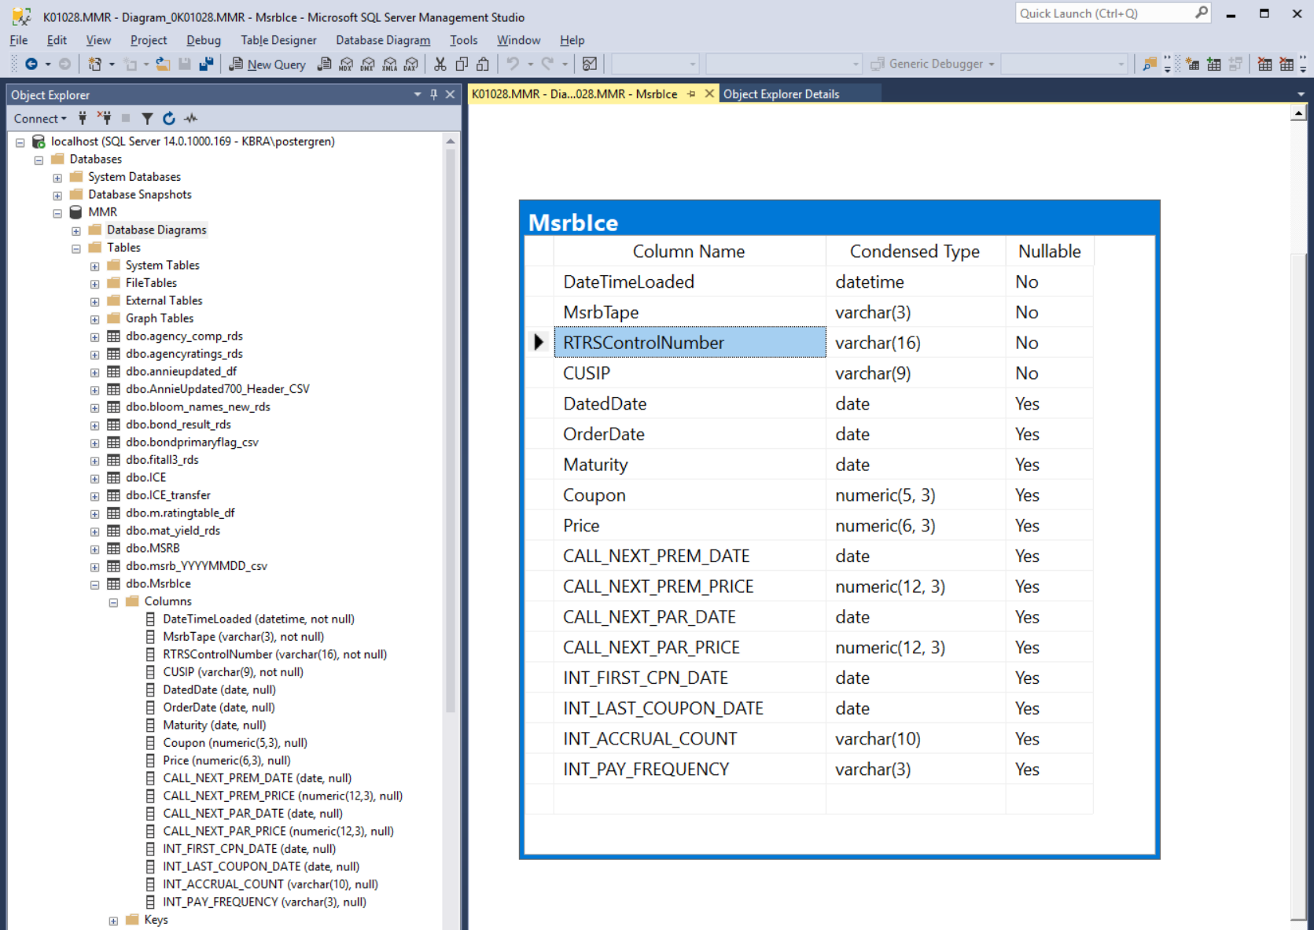
MMR Data Flow
Notes:
No checksum column was added The column below the blue highlighted item are the columns that were originally sent to the CSV files. The columns above are for ETL and maintenance purposes. This table will be updated daily.

Slide 34
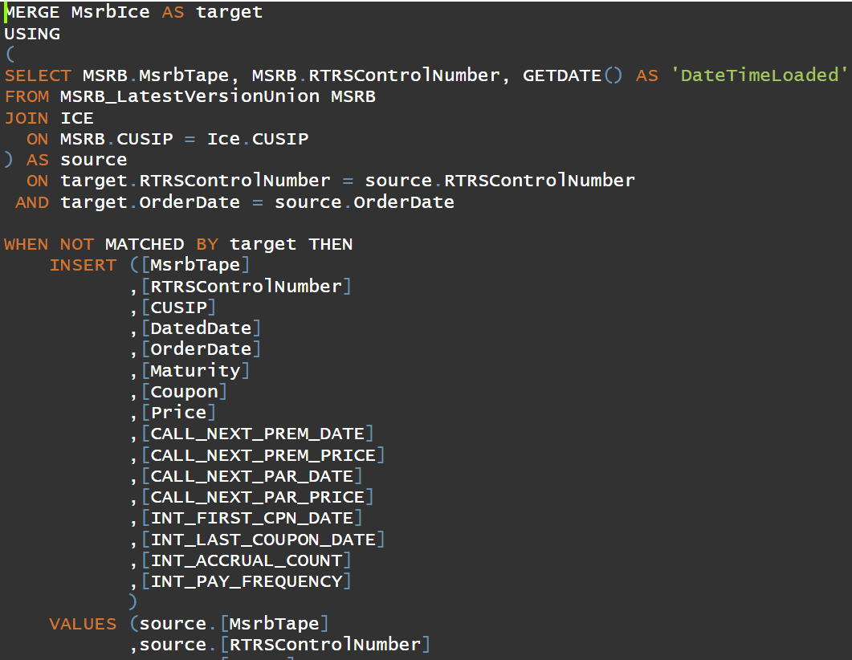
MMR Data Flow
Notes:
Remember, we begin with the draft versions T1’s , then the edited versions T5’s usually pick up some trades (manual corrections that did not make it into the automated system?) , and the final versions usually have less (voids?). We need to insert the new trades daily, change the edited trades when they arrive and also delete trades that did not clear.

Slide 35
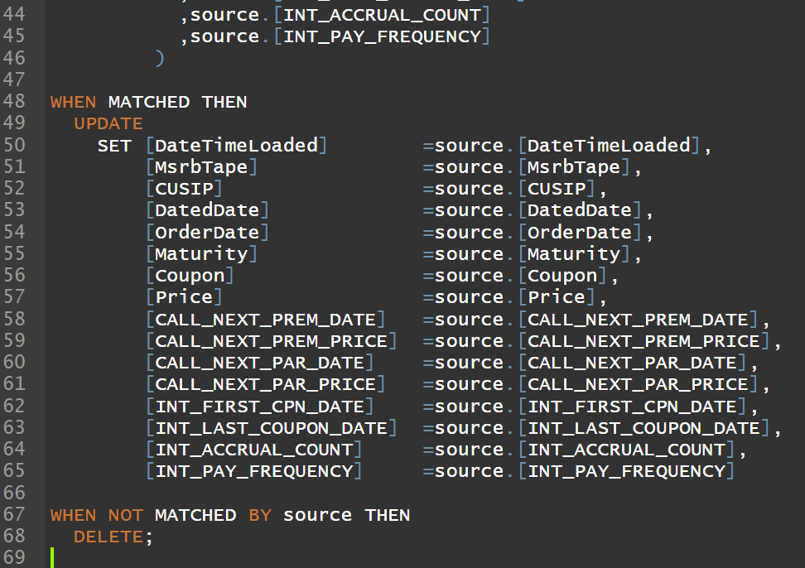
MMR Data Flow
Notes:
Finally the third and fourth clauses of the MERGE statement complete the process.
The four clause of the MERGE:
source
NOT MATCHED target – insert
MATCHED – update
NOT MATCHED source - delete

Slide 36
Summary
We hope we have provided:
Insight into the Quant’s need for us.
A glimpse of a particular product that may be of value to KBRA

